Slide 1
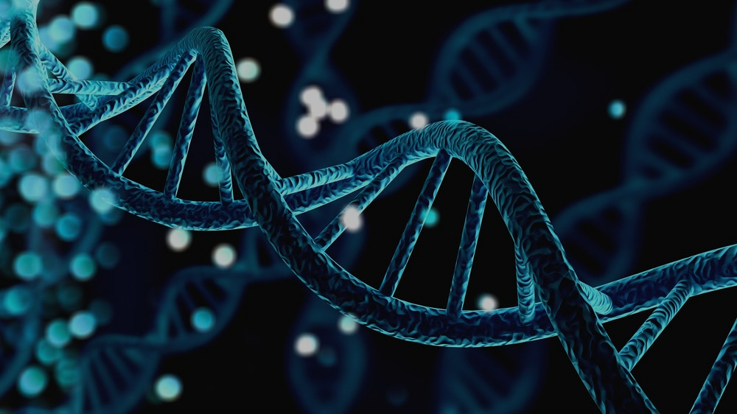
KQC Presentation: Protein Structure
Department of Systems Biology
In Kwon Chung
2022. 12. 15

Slide 2
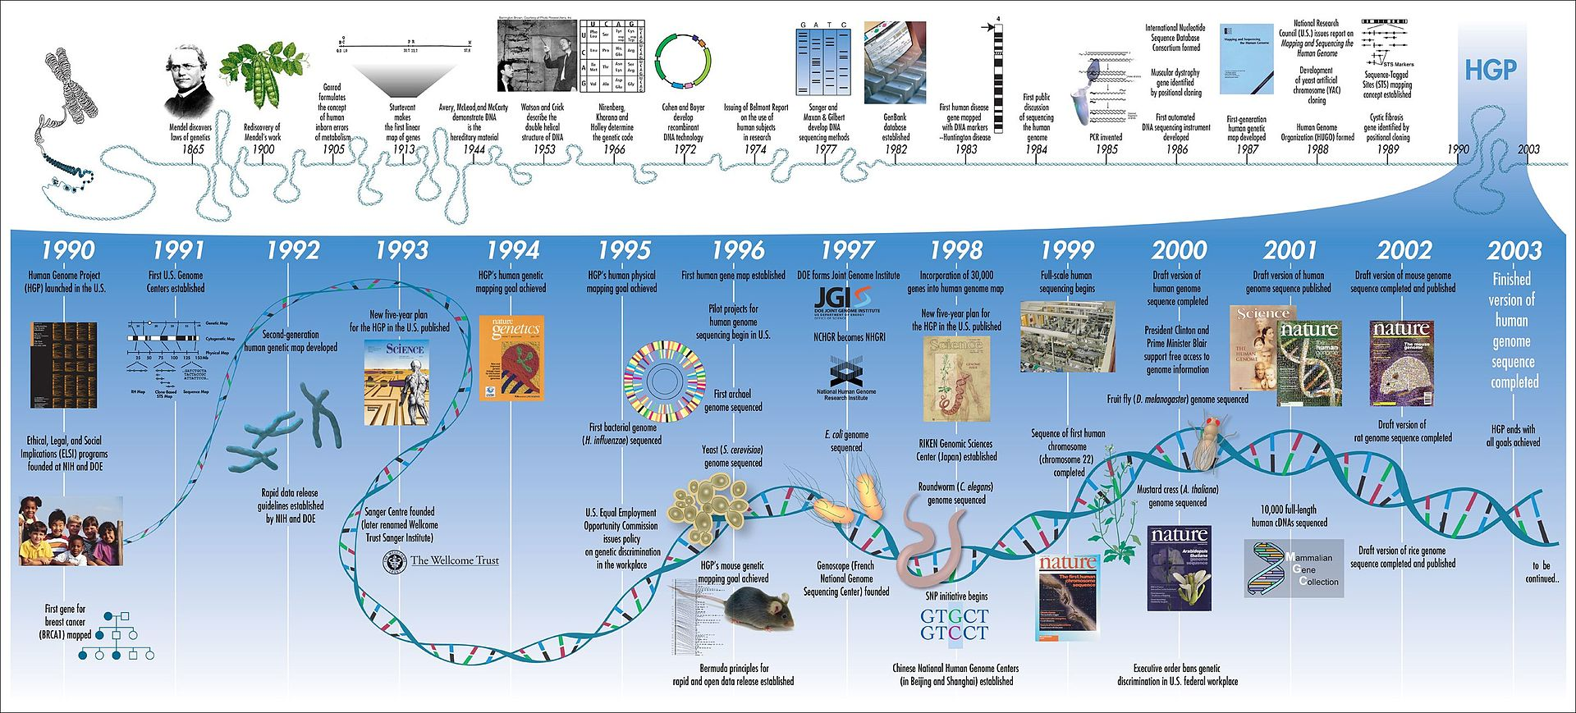
The year-by-year progress of Human Genome Project (HGP)

Slide 3
Computational Biology
► Computational biology refers to the use of data analysis, mathematical modeling and computational simulations to understand biological systems and relationships.
► An intersection of computer science, biology, and big data, the field also has foundations in applied mathematics, chemistry, and genetics.
► Bioinformatics (the analysis of informatics processes in biological systems) began in the early 1970s. At this time, research in artificial intelligence was using network models of the human brain in order to generate new algorithms. This use of biological data pushed biological researchers to use computers to evaluate and compare large data sets in their own field.
► The best-known example of computational biology, the Human Genome Project, officially began in 1990. By 2003, the project had mapped around 85% of the human genome, satisfying its initial goals. Work continued, however, and by 2021 level "complete genome" was reached with only 0.3% remaining bases covered by potential issues. The missing Y chromosome was added in January 2022.
► Since the late 1990s, computational biology has become an important part of biology, leading to numerous subfields. Today, the International Society for Computational Biology recognizes 21 different 'Communities of Special Interest', each representing a slice of the larger field. In addition to helping sequence the human genome, computational biology has helped create accurate models of the human brain, map the 3D structure of genomes, and model biological systems.

Slide 4
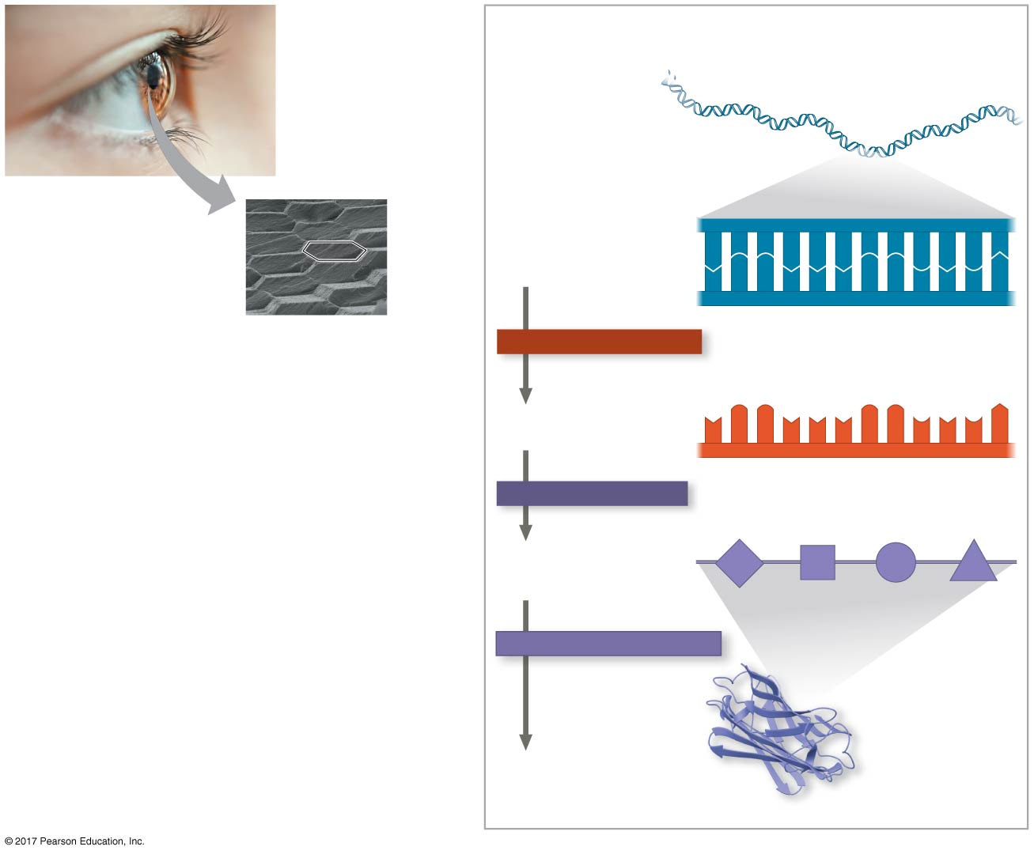
Cells use information in DNA to make functional proteins
Gene in DNA
Genomics (~20,000 genes in human genome):
DNA sequencing
Single nucleotide polymorphism (SNP)
DNA mutations . . .
DNA
A
C
C
A
A
A
C
C
G
A
G
T
T
G
G
T
T
T
G
G
C
T
C
A
TRANSCRIPTION
Transcriptomics:
Transcription
Alternative splicing
mRNA stability . . .
mRNA
U
G
G
U
U
U
G
G
C
U
C
A
TRANSLATION
Proteomics:
Protein expression in specific type of cells
Protein modification
Protein-protein interaction
Protein stability
Protein trafficking . . .
Chain of amino acids
PROTEIN FOLDING
Protein folding (3-dimensional structure):
Protein folding
Important for new drug discovery and biotechnology. . .
Protein
Functional protein

Slide 5
Proteins include a diversity of structures, resulting in a wide range of functions
► Proteins account for more than 50% of the dry mass of most cells.
► Some proteins speed up chemical reactions. Enzymes are proteins that act as catalysts to speed up chemical reactions.
► Other protein functions include defense, storage, transport, cellular communication, movement, and structural support.
► Proteins are all constructed from the same set of 20 amino acids
► Polypeptides (chain of amino acids) are unbranched polymers built from these amino acids
► A protein is a biologically functional molecule that consists of one or more polypeptides

Slide 6
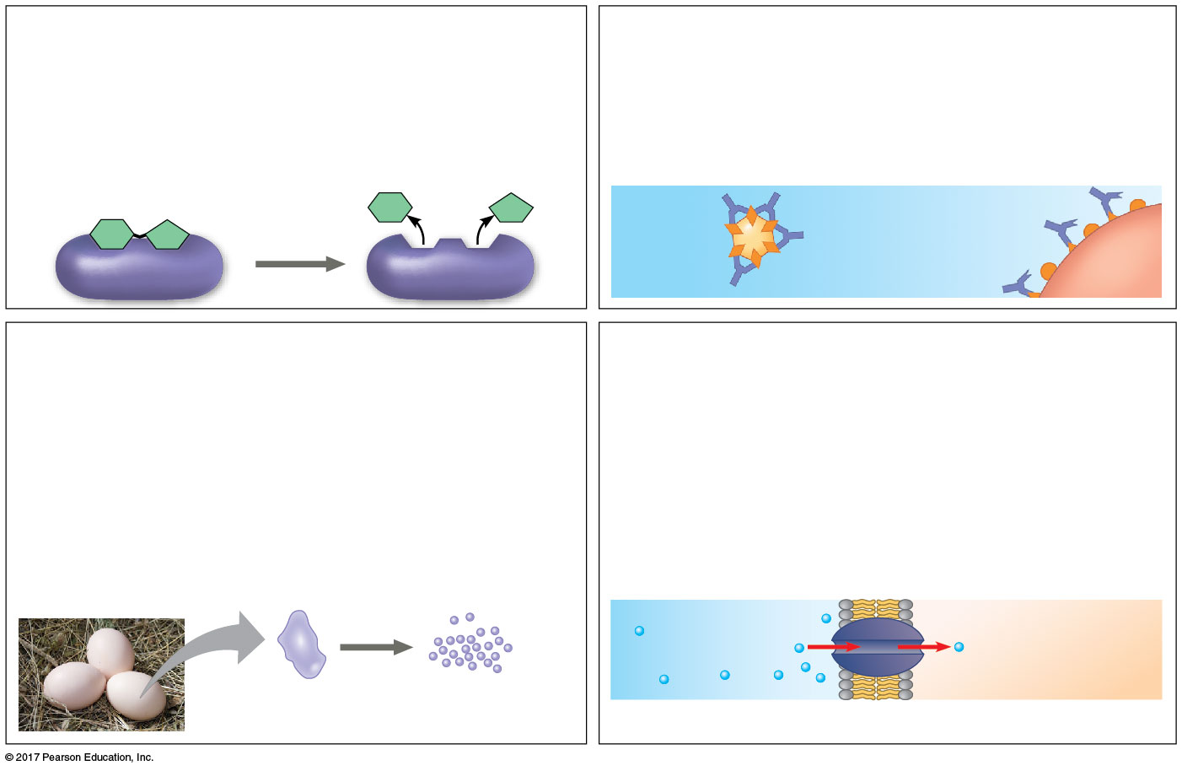
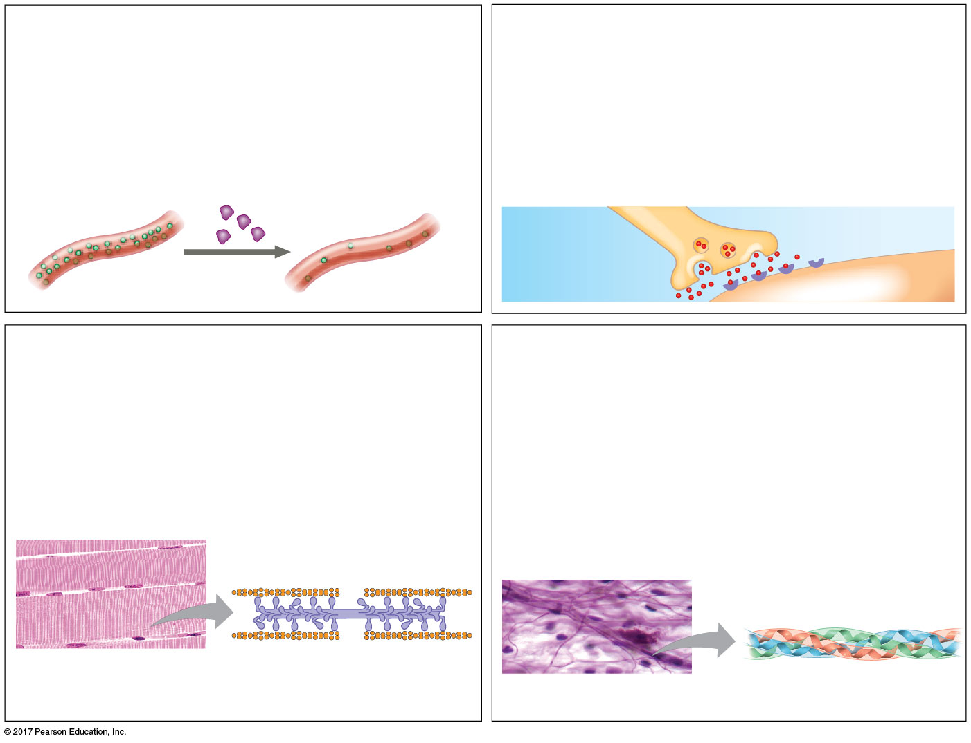
Proteins include a diversity of structures, resulting in a wide range of functions
Enzymatic proteins
Defensive proteins
Hormonal proteins
Receptor proteins
Function: Selective acceleration of
chemical reactions
Function: Protection against disease
Function: Coordination of an organism’s activities
Function: Response of cell to chemical stimuli
Example: Digestive enzymes catalyze the
hydrolysis of bonds in food molecules.
Example: Antibodies inactivate and help
destroy viruses and bacteria.
Example: Insulin, a hormone secreted by the pancreas, causes other tissues to take up glucose, thus regulating blood sugar concentration.
Example: Receptors built into the membrane of a nerve cell detect signaling molecules released by other nerve cells.
Antibodies
Receptor
protein
Enzyme
Bacterium
Signaling
molecules
Virus
High
blood sugar
Insulin
secreted
Normal
blood sugar
Storage proteins
Transport proteins
Contractile and motor proteins
Structural proteins
Function: Storage of amino acids
Function: Transport of substances
Function: Movement
Function: Support
Examples: Casein, the protein of milk, is
the major source of amino acids for baby
mammals. Plants have storage proteins in
their seeds. Ovalbumin is the protein of
egg white, used as an amino acid source
for the developing embryo.
Examples: Hemoglobin, the iron-containing
protein of vertebrate blood, transports
oxygen from the lungs to other parts of the
body. Other proteins transport molecules
across membranes, as shown here.
Examples: Motor proteins are responsible for the undulations of cilia and flagella. Actin and myosin proteins are responsible for the contraction of muscles.
Examples: Keratin is the protein of hair, horns, feathers, and other skin appendages. Insects and spiders use silk fibers to make their cocoons and webs, respectively. Collagen and elastin proteins provide a fibrous framework in animal connective tissues.
Actin
Myosin
Transport
protein
Collagen
Ovalbumin
Amino acids
for embryo
Muscle
tissue
30 µm
Connective
tissue
Cell membrane
60 µm

Slide 7
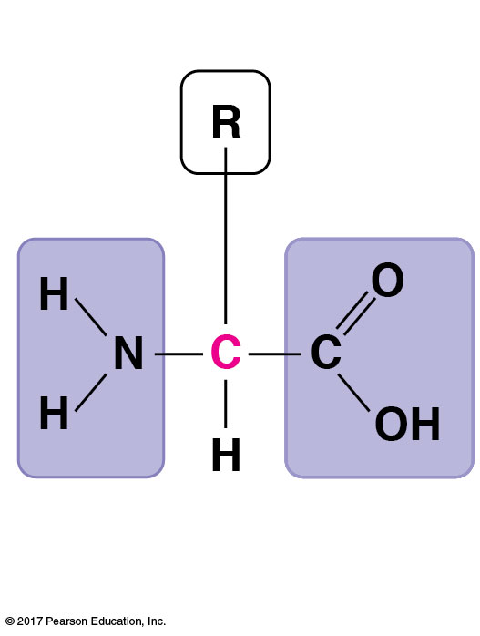
Amino acid monomers
► Amino acids are organic molecules with amino and carboxyl groups.
► Amino acids differ in their properties due to differing side chains, called R groups.
Side chain (R group)
α carbon
Amino group
Carboxyl group

Slide 8
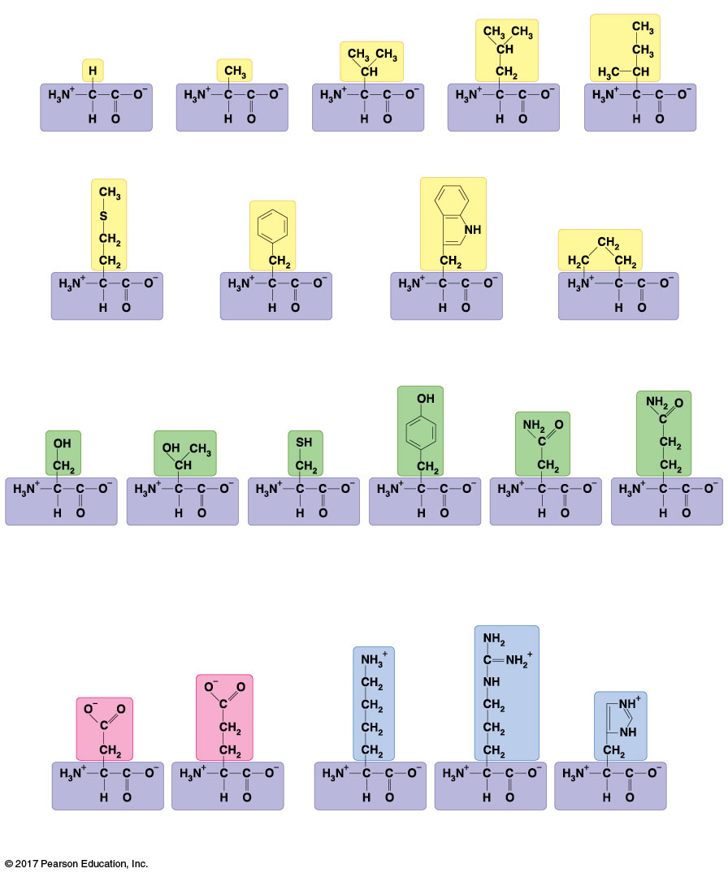
The 20 amino acids of proteins
Nonpolar side chains; hydrophobic side chain (R group)
Polar side chains; hydrophilic
Glycine
(Gly or G)
Alanine
(Ala or A)
Valine
(Val or V)
Leucine
(Leu or L)
Isoleucine
(Ile or I)
Serine
(Ser or S)
Threonine
(Thr or T)
Cysteine
(Cys or C)
Tyrosine
(Tyr or Y)
Asparagine
(Asn or N)
Glutamine
(Gln or Q)
Methionine
(Met or M)
Phenylalanine
(Phe or F)
Tryptophan
(Trp or W)
Proline
(Pro or P)
Electrically charged side chains; hydrophilic
Basic (positively charged)
Acidic (negatively charged)
Aspartic acid
(Asp or D)
Glutamic acid
(Glu or E)
Lysine
(Lys or K)
Arginine
(Arg or R)
Histidine
(His or H)

Slide 9
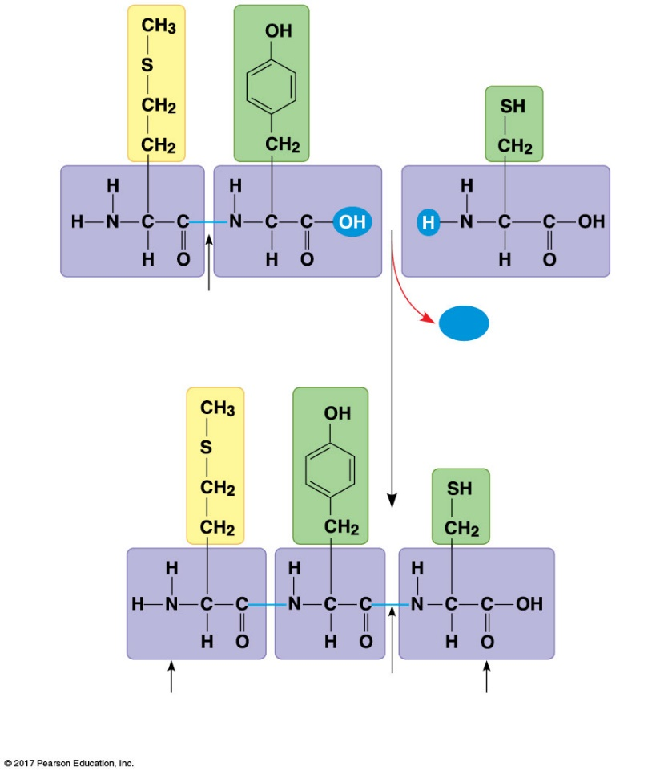
Polypeptides (amino acid polymers)
► Amino acids are linked by covalent bonds called peptide bonds.
► A polypeptide is a polymer of amino acids.
► Polypeptides range in length from a few to more than 1,000 monomers.
► Each polypeptide has a unique linear sequence of amino acids, with a carboxyl end (C-terminus) and an amino end (N-terminus).
Peptide bond
H₂O
Side chains
(R groups)
New peptide bond forming
Backbone
Making a polypeptide chain
Amino end
(N-terminus)
Peptide
bond
Carboxyl end
(C-terminus)

Slide 10
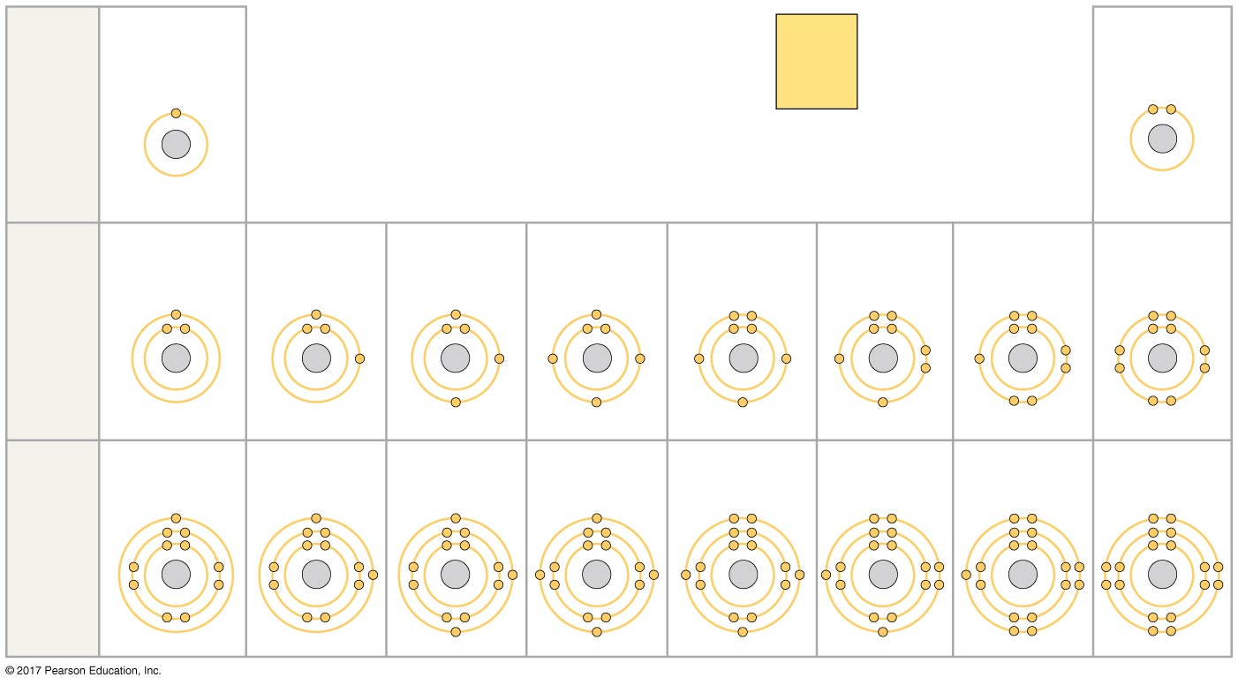
Periodic table
Chemical bonds involved in protein structure
Hydrogen
2
Atomic number
Helium
1
H
He
2
He
First
shell
Atomic mass
4.003
Element symbol
Electron
distribution
diagram
Lithium
Beryllium
Boron
Carbon
Nitrogen
Oxygen
Fluorine
Neon
3
Li
4
Be
5
B
6
C
7
N
8
O
9
F
10
Ne
Second
shell
Sodium
Magnesium
Aluminum
Silicon
Phosphorus
Sulfur
Chlorine
Argon
11
Na
12
Mg
13
AI
14
SI
15
P
16
S
17
CI
18
Ar
Third
shell

Slide 11
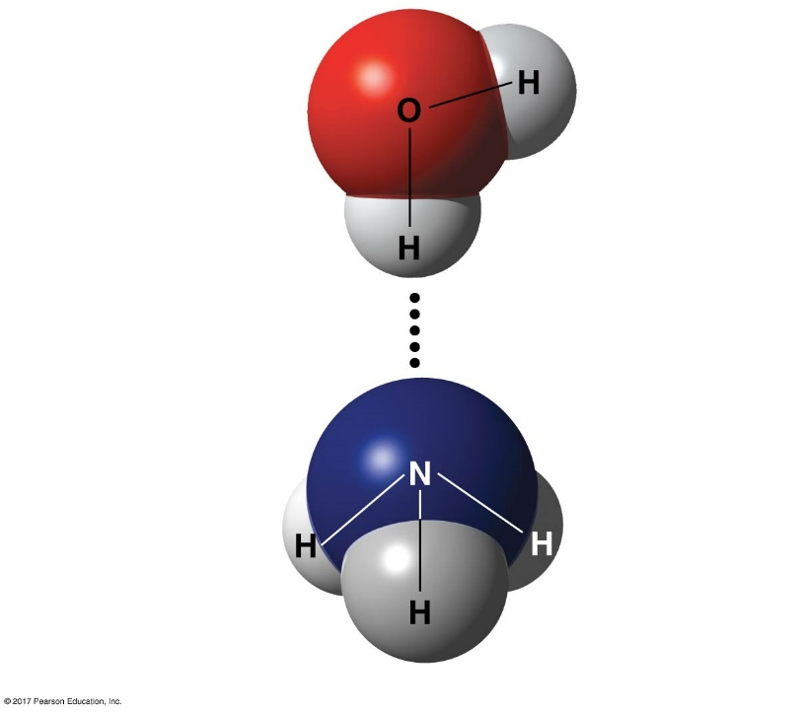
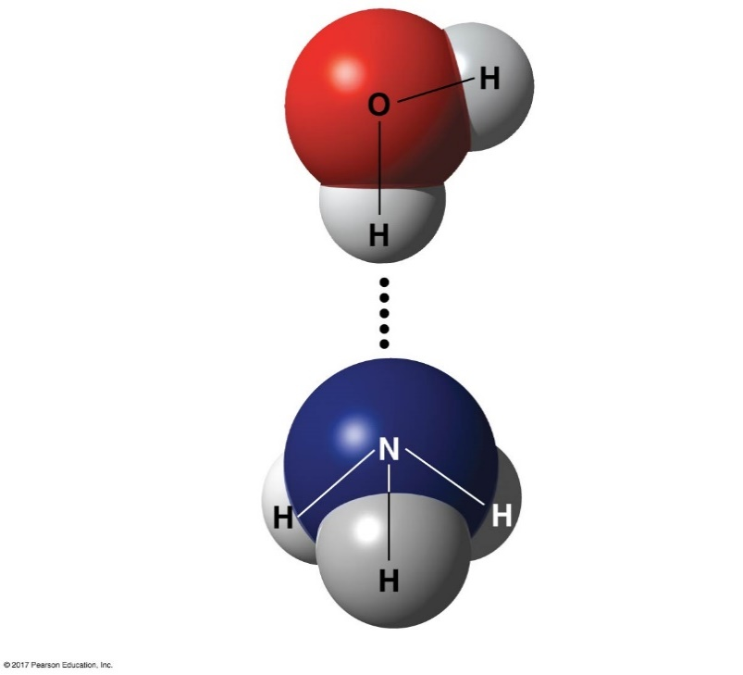
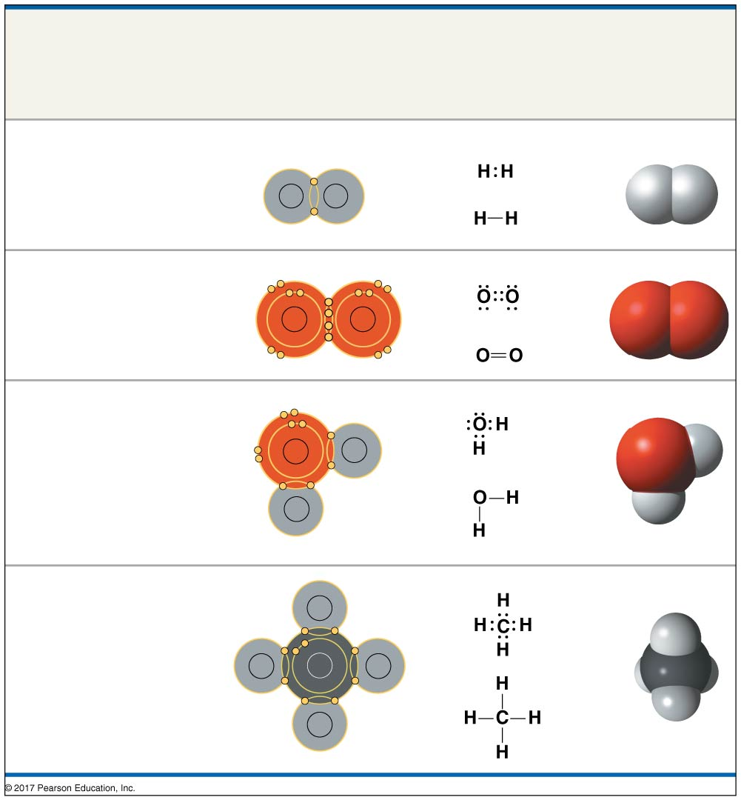
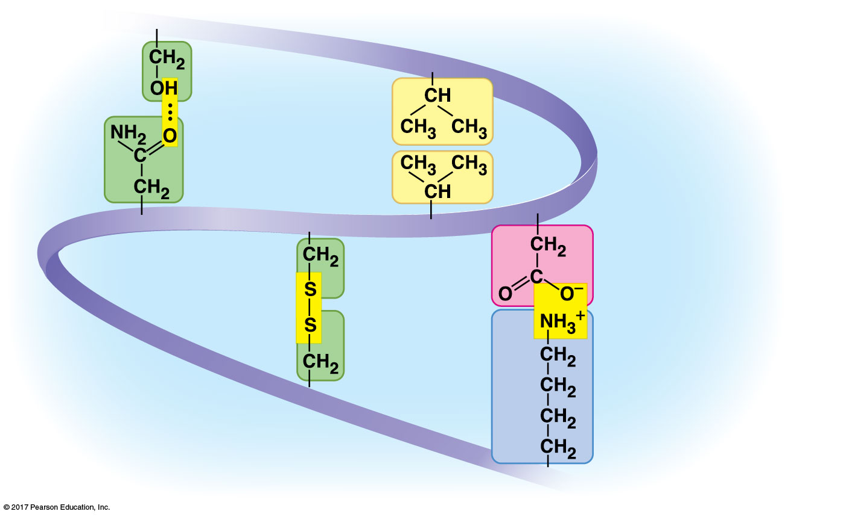
Chemical bonds involved in protein structure (I)
Covalent bond
Hydrogen bond
δ-
δ+
δ-
δ+
Oxygen (O₂)
Water (H₂O)
O
O
δ+
δ+
Hydrogen bond
Nonpolar covalent bond
δ-
Ammonia (NH₃)
Water (H₂O)
δ+
δ+
δ-
δ+
O
H
Electronegativity is the tendency for an atom of a given chemical element to attract shared electrons when forming a chemical bond (O=3.44, N=3.04, C=2.55, H=2.2).
δ+
H
δ+
Polar covalent bond
Serine
Hydrogen
bond
Asparagine

Slide 12
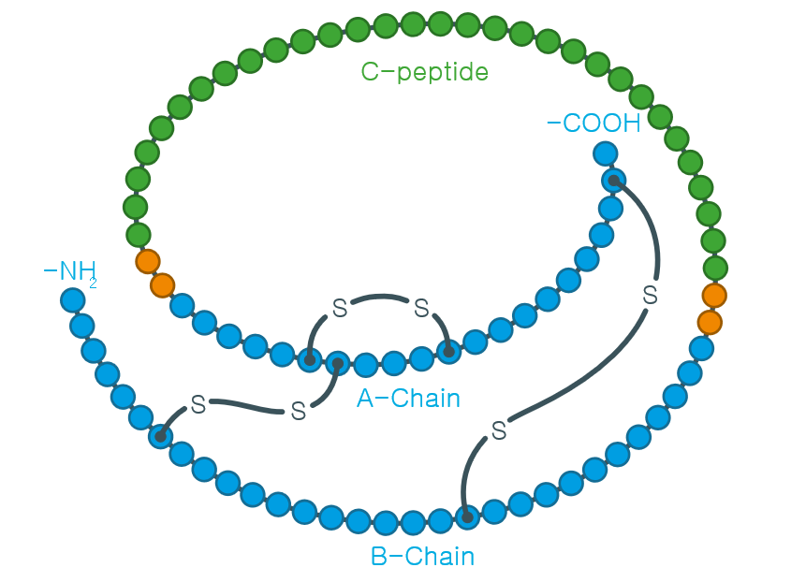
Chemical bonds involved in protein structure (II)
Disulfide bridge
Ionic bond, Hydrophobic interaction, van der Waals interaction
Cysteine
Disulfide bridge
Cysteine
Electronegativity: O=3.44, N=3.04, C=2.55, H=2.2
Cysteine
Valine
Hydrophobic interactions and van der Waals
interactions
Valine
Aspartic acid
Ionic bond
Lysine
Correct structure and disulfide bridge pairing of insulin

Slide 13
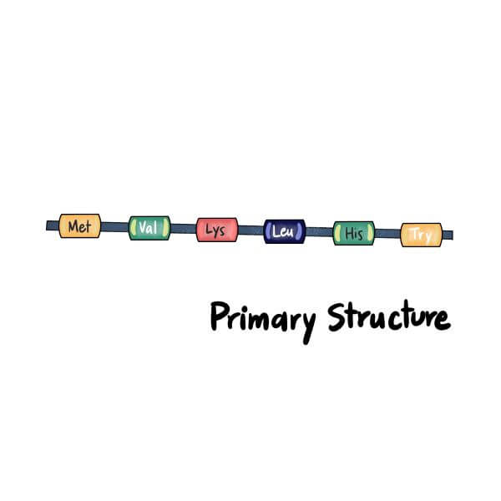
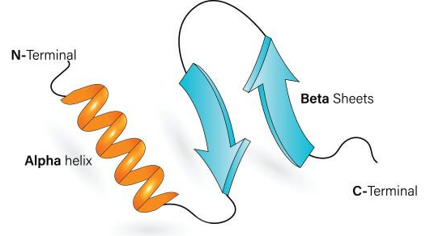
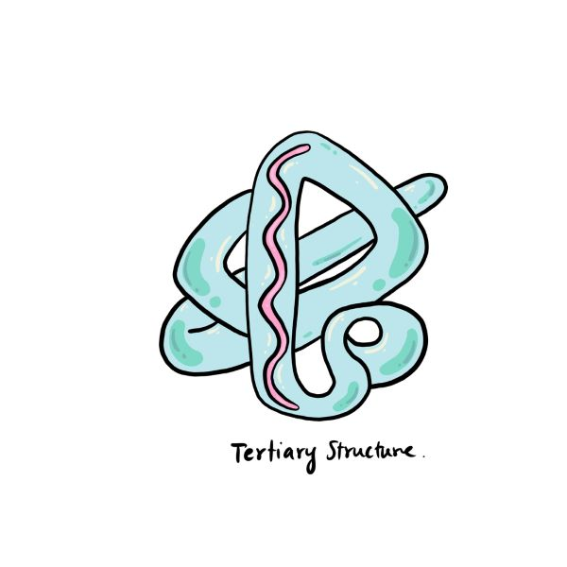
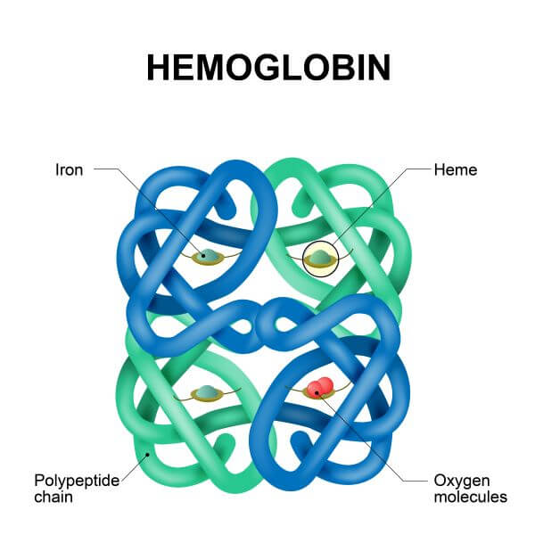
Four levels of protein structure-primary, secondary, tertiary and quaternary
► The function of a protein is highly dependent on its 3D structure.
► The amino acid sequence of a polypeptide chain determines the final 3D structure of the protein.
► There are four levels of protein structure; the primary structure, the secondary structure, the tertiary structure, and the quaternary structure.
► Often, post-translational modifications, such as glycosylation or phosphorylation, occur which are necessary for the biological function of the protein.
► While the amino acid sequence makes up the primary structure of the protein, the chemical/biological properties of the protein are very much dependent on the three-dimensional or tertiary structure.
Primary structure: polypeptide chain
Secondary structure: α-helix and β-sheet produced by hydrogen bonds
Tertiary structure: 3D overall fold of the protein
Quaternary structure: Multi-subunit complex

Slide 14
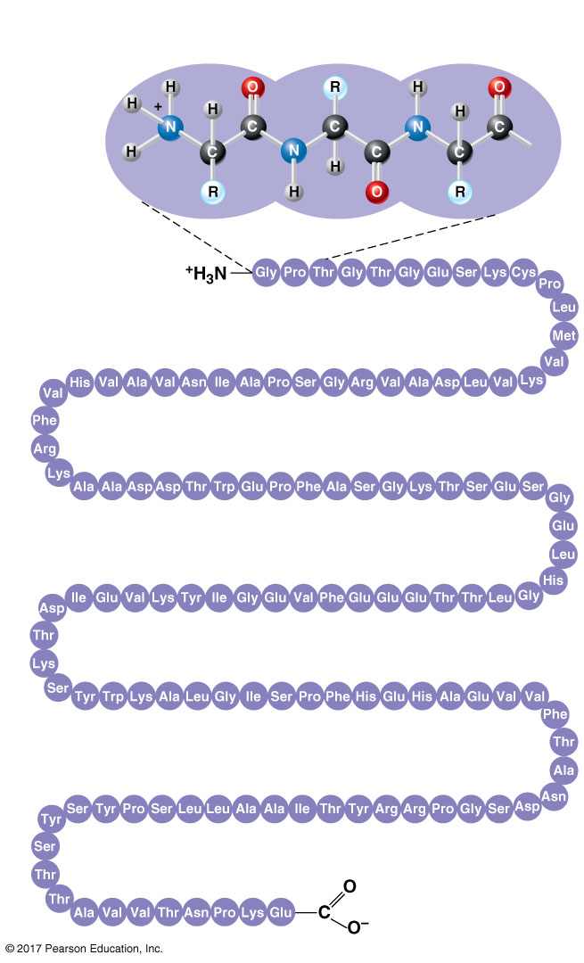
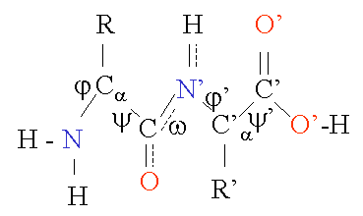
Primary structure
► Primary structure is defined as the amino acid sequence of its polypeptide chain.
► The amino acid sequence of a protein is encoded in DNA.
► Proteins are synthesized by a series of steps called transcription and translation.
► Often, post-translational modifications, such as glycosylation or phosphorylation, occur which are necessary for the biological function of the protein.
► While the amino acid sequence makes up the primary structure of the protein, the chemical/biological properties of the protein are very much dependent on the three-dimensional or tertiary structure.
Torsion angles φ and ψ of
the protein main chain
Amino
acids
70
65
60
55
75
1
5
10
80
85
90
Amino end
95
30
25
20
15
115
110
105
100
35
40
45
50
120
125
Carboxyl end

Slide 15
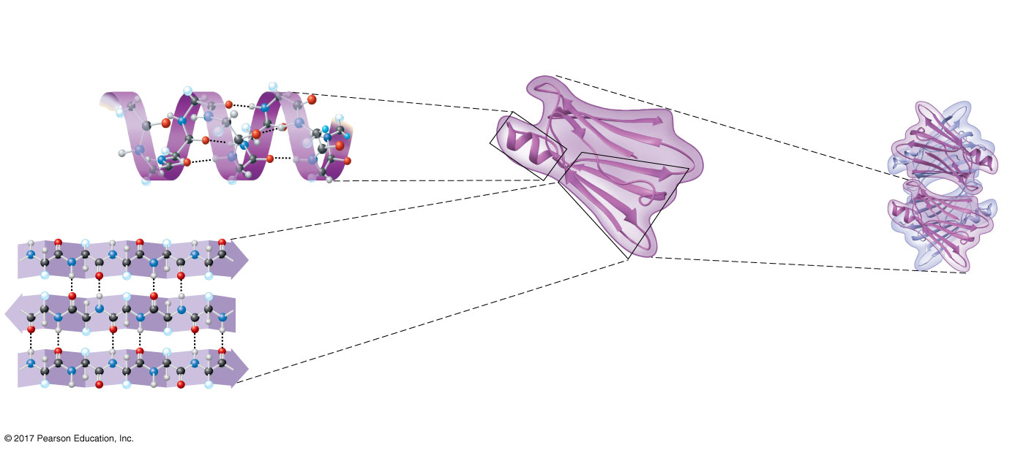
Secondary structure
► Secondary structure is the local spatial arrangement of a polypeptide's backbone (main chain) atoms.
► Polypeptides have distinct, characteristic local structural conformations, or secondary structure, dependent on hydrogen bonding.
► The two main types of secondary structure are the α-helix and the β-sheet.
► The α-helix is a common motif in the secondary structure of proteins and is a right hand-helix conformation in which every backbone N-H group hydrogen bonds to the backbone C=O group of the amino acid located four residues earlier along the protein sequence.
► The β-sheet (also β-pleated sheet) is a common motif of the regular protein secondary structure. β-sheets consist of β-strands connected laterally by at least two or three backbone hydrogen bonds, forming a generally twisted, pleated sheet. A β-strand is a stretch of polypeptide chain typically 3 to 10 amino acids long with backbone in an extended conformation.
α helix
β-pleated sheet
Hydrogen bond
β strand
Hydrogen bond
Hydrogen bond

Slide 16
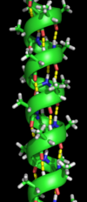
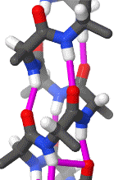
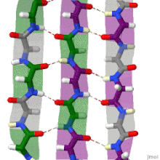
Secondary structure
α helix
β pleated sheet

Slide 17
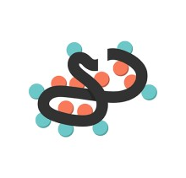
Tertiary structure
► Tertiary structure is the overall three-dimensional shape of a protein molecule is the tertiary structure.
► The protein molecule will bend and twist in such a way as to achieve maximum stability or lowest energy state.
► Although the three-dimensional shape of a protein may seem irregular and random, it is fashioned by many stabilizing forces due to bonding interactions between the side-chain groups of the amino acids.
► Under physiologic conditions, the hydrophobic side-chains of neutral, non-polar amino acids tend to be buried on the interior of the protein molecule, thereby shielding them from the aqueous medium. The alkyl groups of alanine, valine, leucine and isoleucine often form hydrophobic interactions between one another, while aromatic groups such as those of phenylalanine and tyrosine often stack together.
► Acidic or basic amino acid side-chains will generally be exposed on the surface of the protein as they are hydrophilic.
► The formation of disulfide bridges by oxidation of the sulfhydryl groups on cysteine is an important aspect of the stabilization of protein tertiary structure, allowing different parts of the protein chain to be held together covalently.
► Additionally, hydrogen bonds may form between different side-chain groups. These hydrogen bonds can bring together two parts of a chain that are some distance away in terms of sequence.
► Salt bridges, ionic interactions between positively and negatively charged sites on amino acid side chains, also help to stabilize the tertiary structure of a protein.
Hydrophobic region
Hydrophilic region
H₂O
Protein in aqueous solution

Slide 18
Tertiary structure
Secondary Structure
Tertiary Structure
Serine
Hydrogen
bond
Valine
Hydrophobic
interactions and
van der Waals
interactions
α helix
α helix
Asparagine
Valine
Hydrogen bond
β-pleated
sheet
Disulfide
bridge
Cysteine
Aspartic acid
β strand
Ionic bond
Hydrogen
bond
Single polypeptide subunit
Cysteine
Polypeptide
backbone
Lysine
β-pleated sheet
Chemical bonds involved in tertiary structure

Slide 19
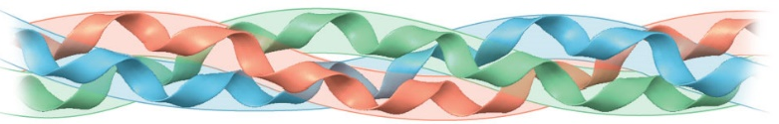
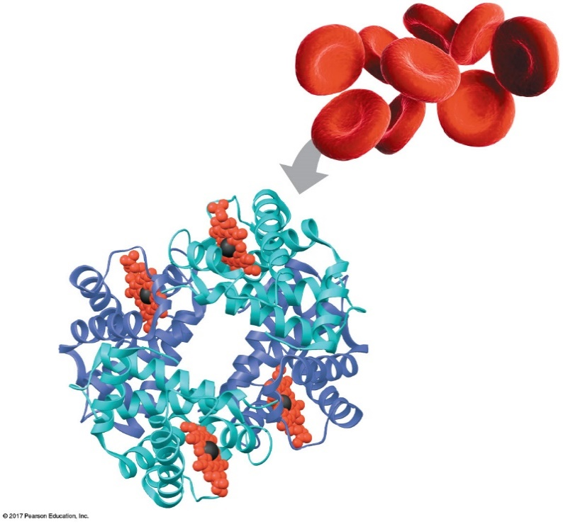
Quaternary structure
► Quaternary structure is the three-dimensional arrangement of the subunits in a multisubunit protein.
► Many proteins are made up of multiple polypeptide chains, often referred to as protein subunits. These subunits may be the same, as in a homodimer, or different, as in a heterodimer.
► The quaternary structure refers to how these protein subunits interact with each other and arrange themselves to form a larger aggregate protein complex. The final shape of the protein complex is once again stabilized by various interactions, including hydrogen-bonding, disulfide-bridges and salt bridges.
Collagen
Secondary Structure
Tertiary Structure
Quaternary Structure
α helix
α helix
Hemoglobin
Hydrogen bond
Single
polypeptide
subunit
Heme
β pleated
sheet
Iron
β strand
β subunit
Hydrogen bond
α subunit
β pleated sheet
α subunit
β subunit

Slide 20
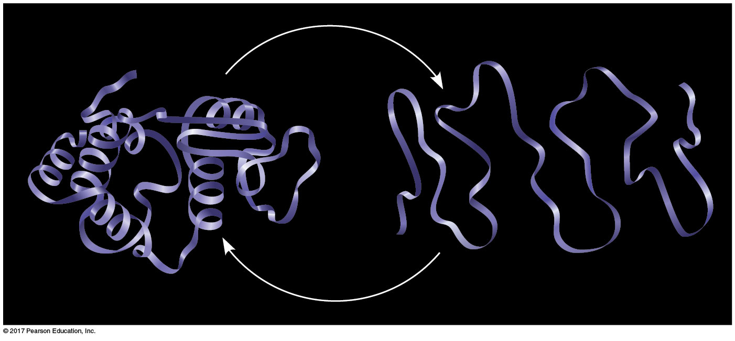


What determines protein structure?
► In addition to primary structure, physical and chemical conditions can affect structure.
► Alterations in pH, salt concentration, temperature, or other environmental factors can cause a protein to unravel.
► This loss of a protein’s native structure is called denaturation.
► A denatured protein is biologically inactive
Denaturation and renaturation of a protein
Normal protein
Denatured protein

Slide 21
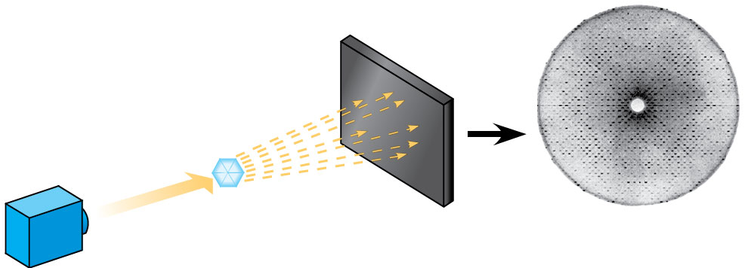
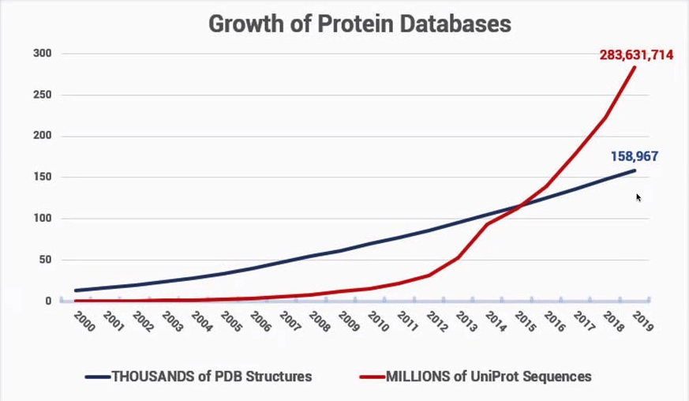
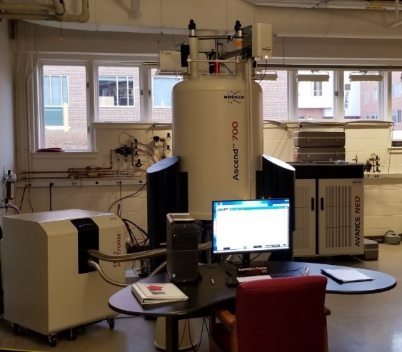
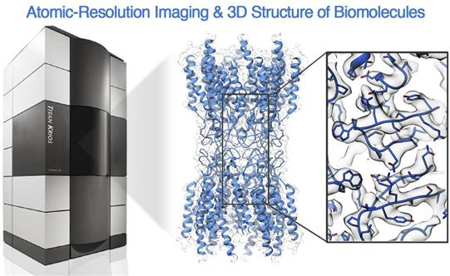
Conventional techniques to determine the protein structure
Diffracted X-rays
X-ray
source
Less than 1% of proteins have
known structures
X-ray
beam
Crystal
Digital detector
X-ray diffraction pattern
X-ray crystallography
Nuclear magnetic resonance
(NMR)
Cryo Electron Microscopy
(CryoEM)

Slide 22
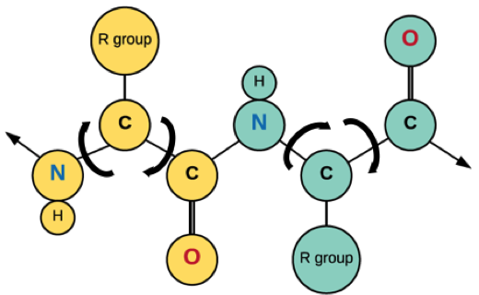
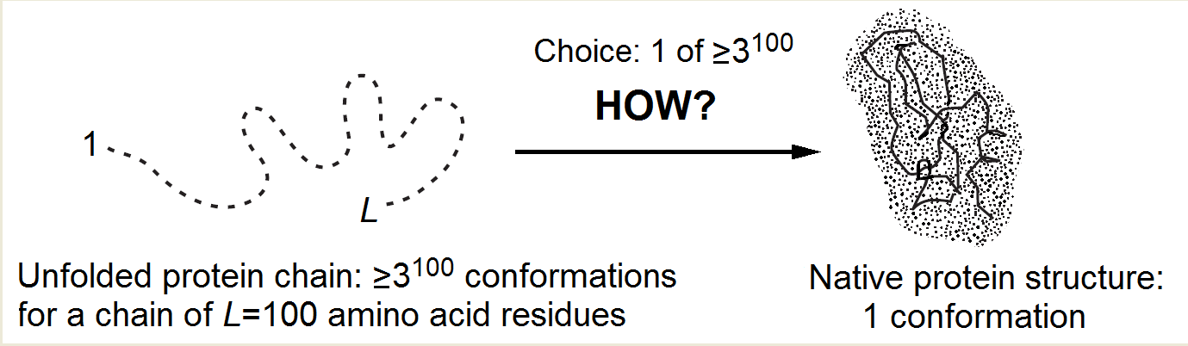
Levinthal’s Paradox in 1969
► There are vastly too many possible conformations for a protein to fold by a random search.
► Consider just for the peptide backbone, there are 3 conformations per amino acid in the unfolded state.
► For a 100 amino acid protein, we have 3¹⁰⁰ conformations.
► If the chain can sample 10¹² conformations/sec, it takes 5 x 10³⁵ sec (2 x 10²⁸ year).
► Even with the help of computers, which can test each possible shape in microseconds, testing them all would require 30 years of computation just for one protein.
► If our cells approached the problem by classical sampling (check-each-possible-fold approach), it would take forever. But our cells have a mechanism that allows this to be done in micro- to milliseconds.
► The discrepancy between this large estimate and the real folding times of proteins is commonly referred as the Levinthal’s paradox.
φ
ψ
α
α
The bonds within the amino acids can
rotate and account for 3 conformations.
The Levinthal's choice problem

Slide 23
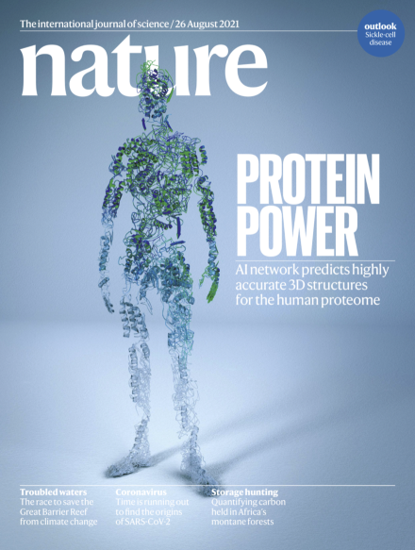
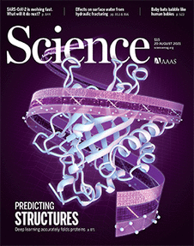
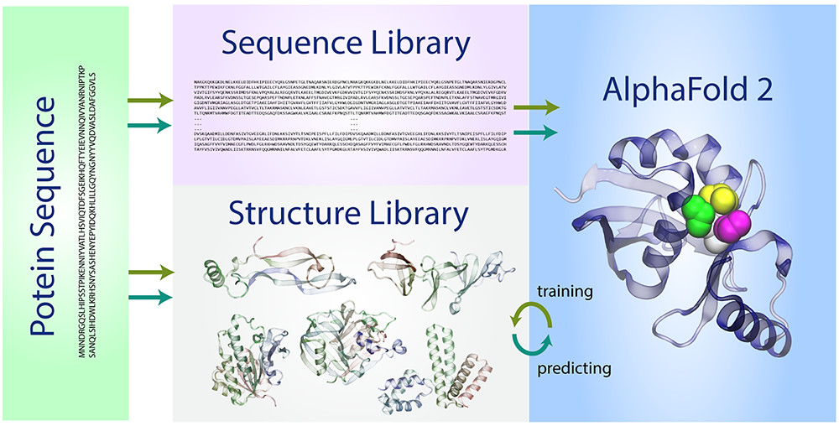
Highly Accurate Protein Structure Prediction
DeepMind’s Alphafold2: Protein structure prediction is achieved by deep learning-based methods in predicting the 3D structures of proteins and protein complexes, essentially solving this long-standing challenge.
UW’s RoseTTAfold: New deep learning software can predict protein structures in minutes, allowing the network to collectively reason about the relationship between a protein's amino acid sequence and its folded structure.
Nature 2021 August
Method of the Year 2021
Alphafold2
Science 2021 August
RoseTTAfold

Slide 24
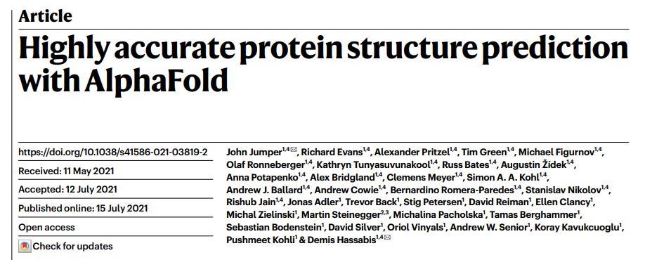

Slide 25
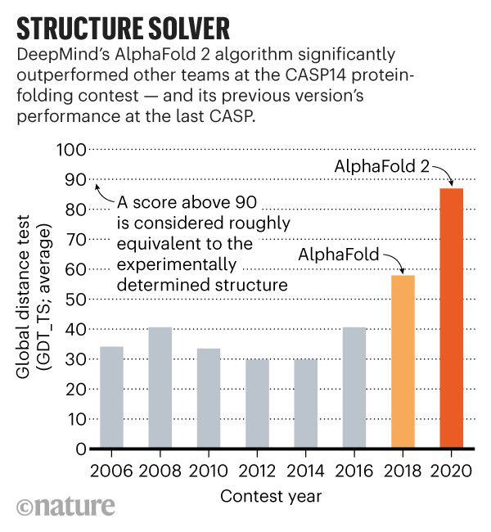
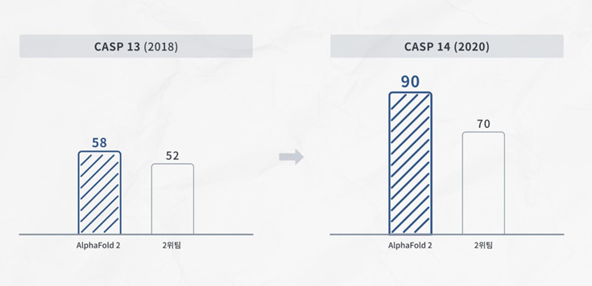
Critical Assessment of Protein Structure Prediction (CASP)
In 1994, scientists interested in protein folding formed CASP (Critical Assessment of protein Structure Prediction)
CASP14 (2020. 12.)

Slide 26
AlphaFold 2 Model Analysis
Input feature embeddings
(MSA를 통해 embedding 수행)
Evoformer
(Transformer neural network, 즉
attention algorithm 적용)
Structure module
(각 amino acid의 위치백터와
방향백터를 GNN을 통해 출력)

Slide 27
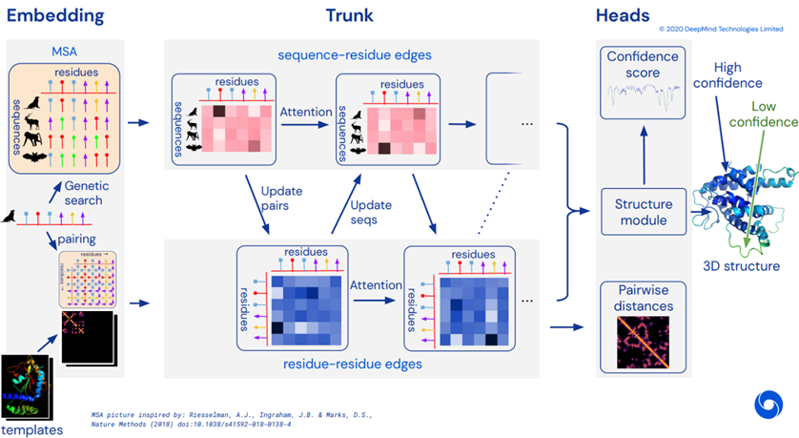
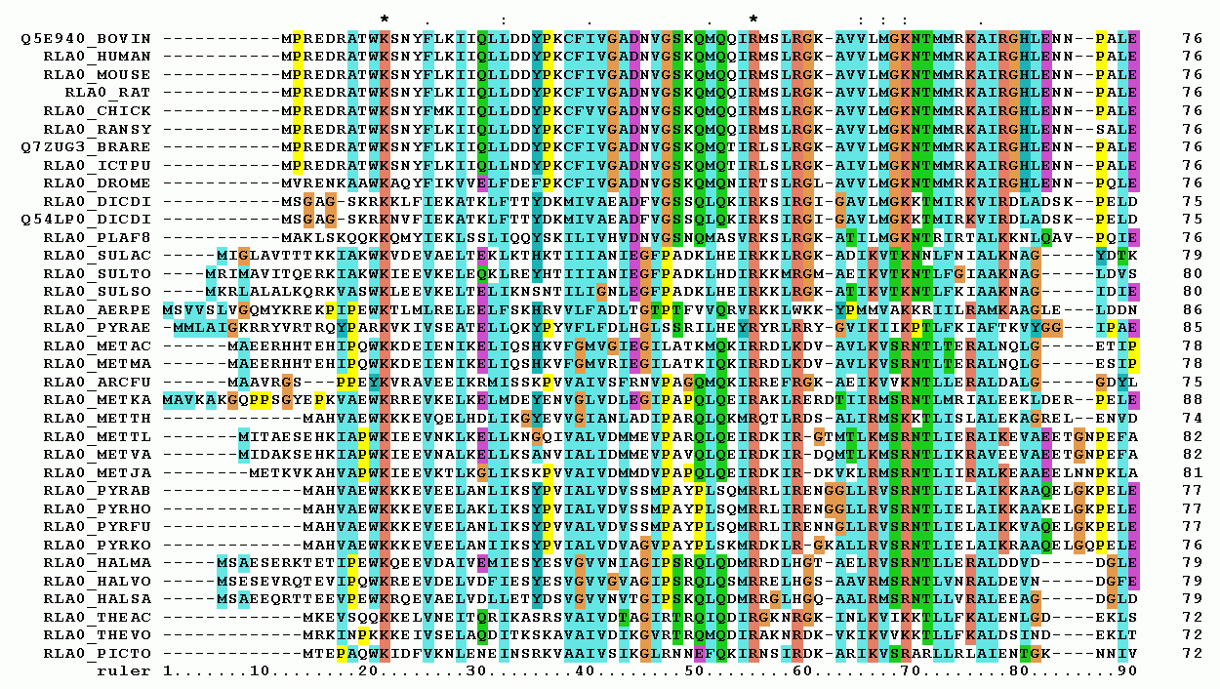
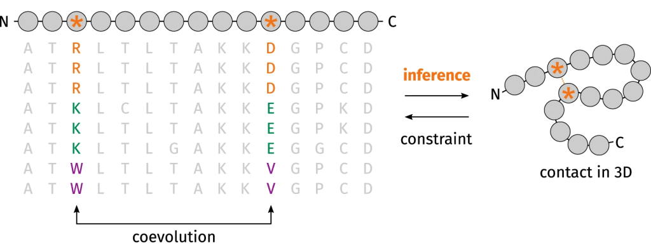
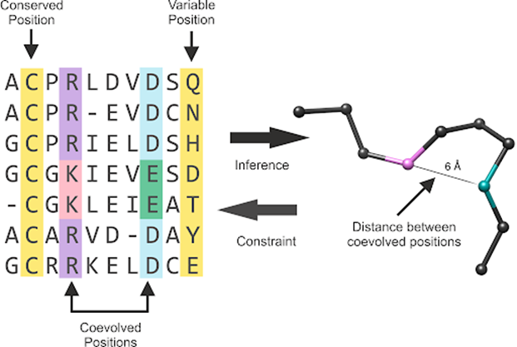
1. Embedding stage: Multiple Sequence Alignment (MSA) and pair representation
MSA는 amino acid sequence가 얼마나
비슷한 지 비교하기 위해 사용하는 기술
Pair representation: 아미노산이 서로 접촉할 가능성이 있는 모델
K

Slide 28
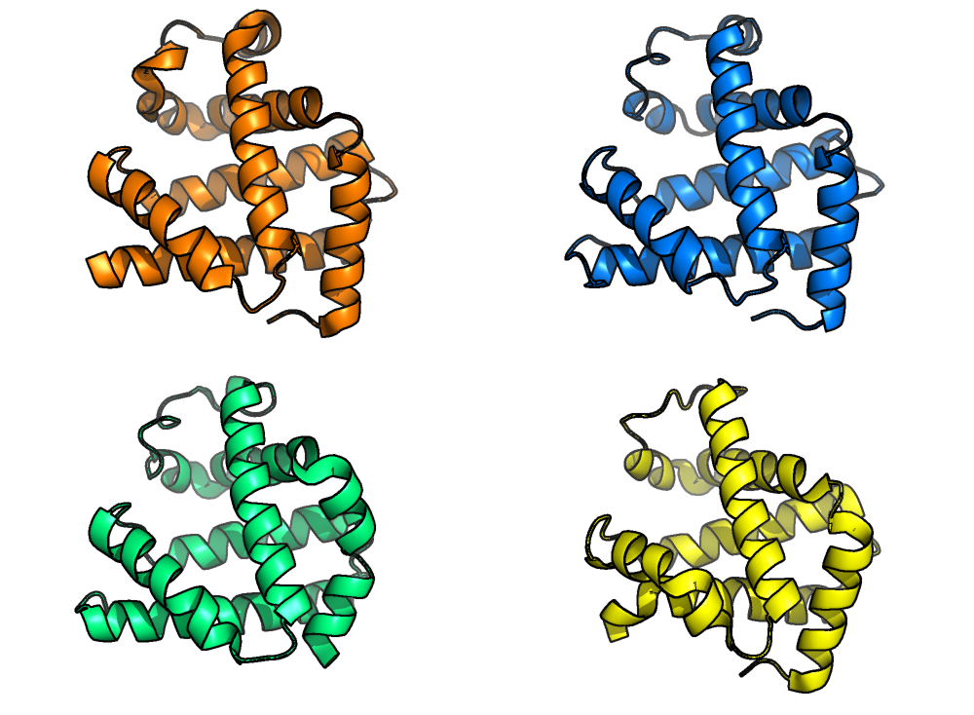
Myoglobin
Human myoglobin
African elephant myoglobin
(80% sequence identity)
Pigeon myoglobin
(25% sequence identity)
Blackfin tuna myoglobin
(45% sequence identity)

Slide 29
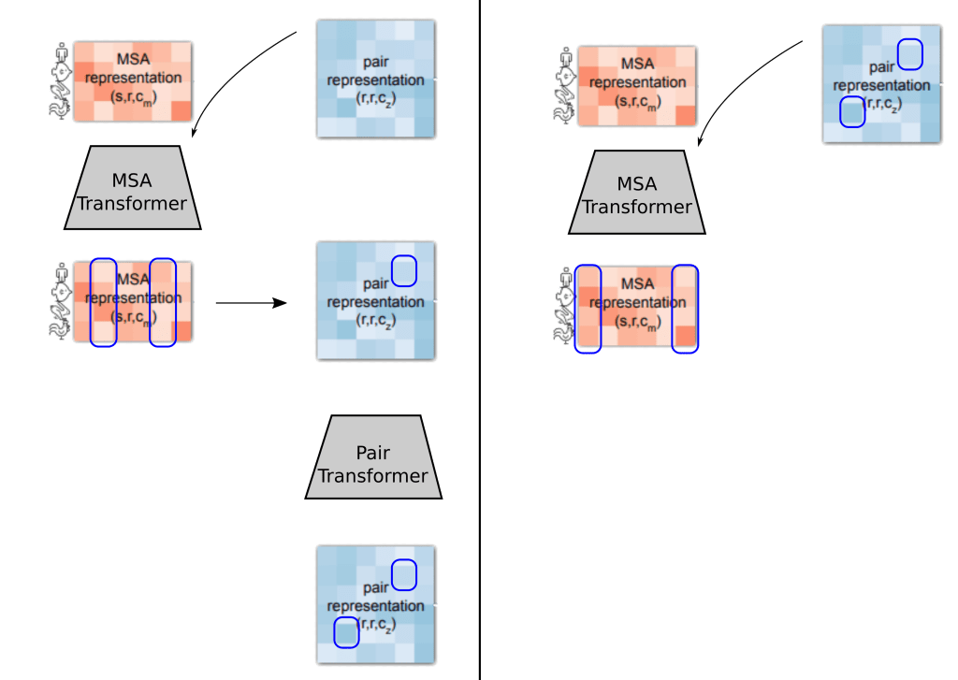
2. Trunk stage: Evoformer (Evolutionary Transformer) module
using attention algorithm
Trunk
Conceptualization of the Evoformer information
Sequence-residue edges: identify a correlation between various amino acid sequences and residues using self-attention algorithm
Residue-residue edges: determine the distance map between various amino acid residues
The MSA transformer identifies a correlation between two columns of the MSA, each corresponding to a residue. This information is passed to the pair representation, where subsequently the pair representation identifies another possible interaction.
The information is passed back to the MSA. The MSA transformer receives an input from the pair representation, and observes that another pair of columns exhibits a significant correlation

Slide 30
3. Head stage: Structure module introduces an explicit 3D structure in the form of a rotation and translation for each residue of the protein
Structure module including Invariant point attention (IPA) module. The single representation is a copy of the first row of the MSA representation.
Residue gas: a representation of each residue as one free-floating rigid body for the backbone (blue triangles) and χ angles for the side chains (green circles). The corresponding atomic structure is shown below.
Frame aligned point error (FAPE). Green, predicted structure; grey, true structure; (Rk, tk), frames; xi, atom positions.

Slide 31
Protein Structure Prediction
Using Quantum Computing?

Slide 32


